Slide 1
The Great Generals of WWII
Roy BenDavid
Per. 5
3/17/13

Slide 2
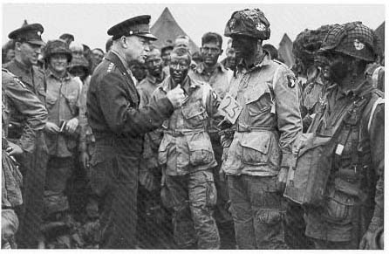
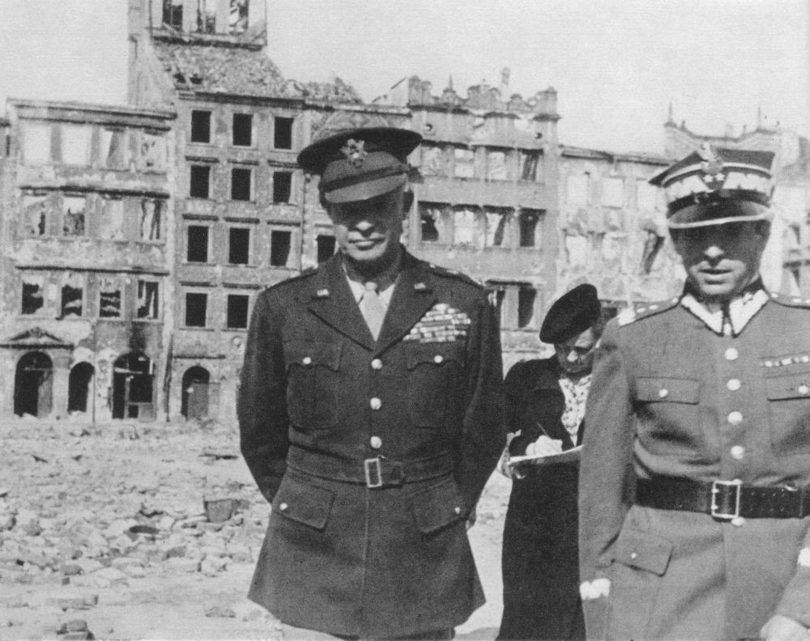
General Dwight Eisenhower (U.S)
Background
  1915 West Point Military Academy graduate
  1917 promoted to Captain and joined WWI
Beginning of WWII
  December 7 1941 Pearl Harbor U.S joined WWII and he became Brigadier General
  June 24 1942 series of promotions ended with him becoming Commander of the European Theater of Operation (ETOUSA)
Campaign in North Africa
  February 11 1943 led the Tunisian Campaign that ended with victory in May
Invasion of Italy
  September 1943 began the initial stages of the Italian invasion
  February 1944 promoted to Supreme Allied Commander
Last Stages of WWII
  June 6 1944 led his army to victory in the invasion of Normandy
  December 19 1944 invasion into Germany halted in the Battle of Bulge that ended in victory but included heavy allied losses
  May 8 1945 German Surrender and his promotion to Military Governor of the U.S Occupation Zone and was in charge of documenting the Nazi atrocities
June 5 1944 Dwight Eisenhower behaving like the natural leader he is and preparing his men for the invasion of Normandy.
September 1945 Dwight Eisenhower in Warsaw, Poland documenting the atrocities of the Nazi

Slide 3
General Dwight Eisenhower (U.S)
What made him a great General?
  He had the rare ability the keep the morale of his soldiers high even during low and depressing times he was able to bring their spirits up
  As a West Point graduate he was a brilliant military strategist and always made sure that his troops were put in the best position to succeed
  He was always loyal to his troops and treated them as individuals and with extreme respect and in return he got the best out of them
  He was a strong and unquestioned leader (Became the 34th president of the U.S) that demanded the best out of his best
  During the the years between WWI and WWII he took the initiative and spent close to a decade furthering his military education with the help of multiple veteran Generals.

Slide 4
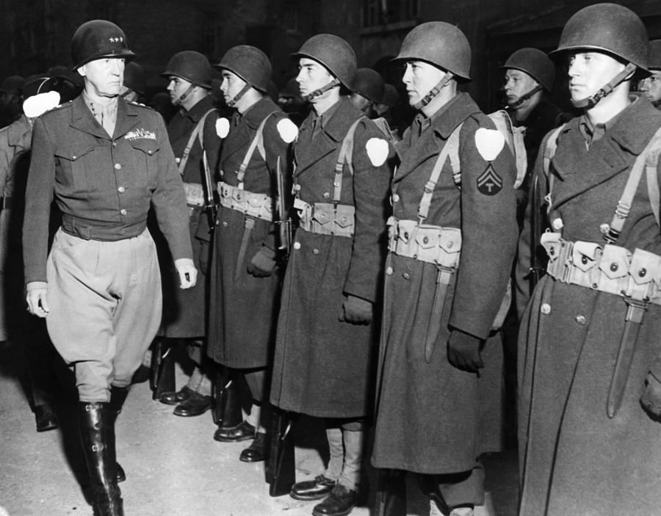
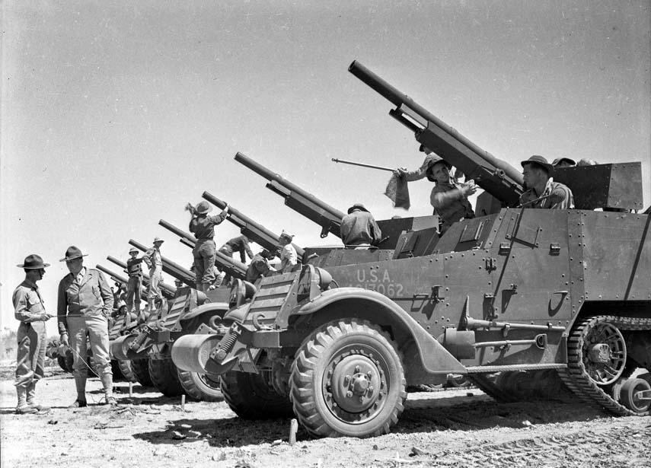
General George Smith Patton Jr. (U.S)
Background
  April 1917 promoted to Captain and joined WWI
  1934 promoted to lieutenant colonel
Beginning of WWII
  1940 took command of the 2nd armored division
  November 1942 during Operation Torch he captured Casablanca, Morocco
Campaign in North Africa
  February 1943 appointed to rebuild the U.S II Corp
  March 1943 led his Corp to victories against the Germans in Tunisia
Invasion of Italy
  April 1943 chosen to help plan the invasion of Sicily
  July 1943 his army arrived in Sicily but after becoming inpatient he took everything into his own hands and after a confrontation with a Private he returned a disgrace
Last Stages of the War
  June 1944 Eisenhower gave him a 2nd chance and allowed him to help led the U.S Third Army Division and play a huge role in invading Normandy
  August 31 1944 he began a rapid campaign into Germany
  December 16 1944 after the Battle of Bulge he spent the rest of the war protecting Ally borders near the Rhine
George Patton inspecting his troops.
George Patton training his troop in the desert the summer before WWII

Slide 5
General George Smith Patton Jr. (U.S)
What made him such a great General?
  He had a very unique personality that was very polished and flashy that was very popular with his troops.
  He was a very controversial General that sometimes was called crazy, he would often do as he wished and often he went against the original plan and often he was successfully able to capture multiple cities that were not part of the original plan
  He always made sure to be ready for anything. The summer before the U.S joined WWII sensing the growing tension Patton gathered his troops together to the desert and prepared them to enter WWII before the U.S was even thinking about joining WWII
  He was a very confident General, he was confident in his ability to win any battle and he had the confidence that his men were able to win any battle and with this confidence he never thought twice about a decision which was a huge part of his success.

Slide 6
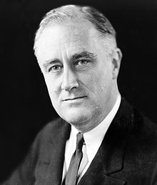
Franklin D. Roosevelt’s affect on his Generals
Was successful in diplomatic negotiations
and through smart negotiations he always
put his generals in the best place to succeed
Very involved in the operations of the
army but let his Generals make most of
the important military decisions
Strong and inspirational leader that
always had the support of the people
with every decisions that he made

Slide 7
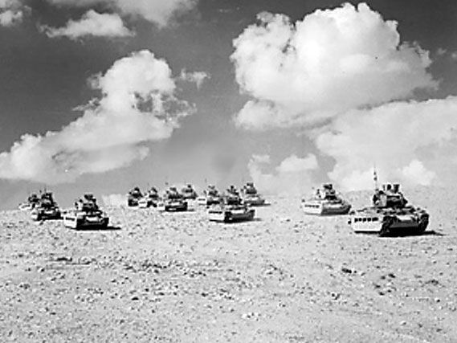
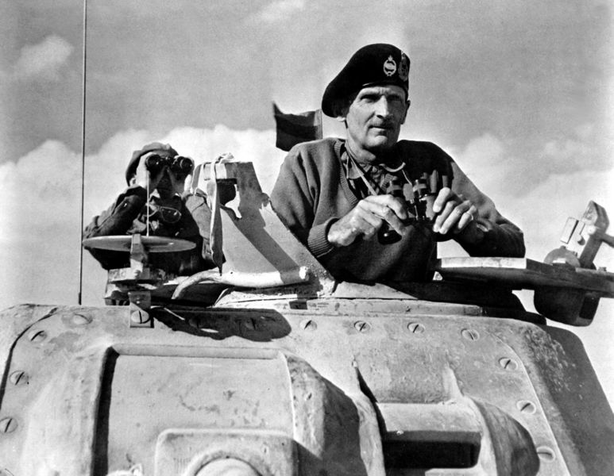
General Bernard Law Montgomery (Great Britain)
Background
  1908 graduated from the Royal Military Academy
  1937 given command of 9th Infantry Brigade
Beginning WWII in France
  May 1940 with the German invasion of the French Low Lands he was sent to France serving in the II Corp and spent the next year defending several British posts
North Africa
  August 13 1942 promoted to Lieutenant General, command of the 8th army in Egypt
  September and October 1942 victories in the Battle of Alam Halfa and the 2nd Battle of El Alamein he was able to push Erwin Rommel and the Germans out of Egypt
Invasion of Italy and Sicily
  July 1943 he left Egypt and began planning the Italian invasion with George Patton
  September 3 1943 he arrived in Italy and began his slow grinding campaign up Italy.
Last stages of WWII
  June 6 1944 during D Day he captured the pivotal city Caen that led to Ally victory
  December 1944 getting past the Battle of the Bulge he was able to lead his men to victory against the Germans in the Rhineland
November 1942, Montgomery overseeing his tanks in battle in North Africa
The tanks sent by Montgomery during the Battle of El Alamein that lead to a huge victory for the British

Slide 8
General Bernard Law Montgomery (Great Britain)
What made him a great General?
  He graduated from the Royal Military Academy and through his experience he was able to become a smart military strategist that really was showed off during his victories in North Africa.
  One of his greatest qualities as a General was that he was a great problem solver. He had the ability to get his troops out of the worst of positions and give them a chance to win the battle.
  He was a very strict General and always made sure to discipline his troops whenever needed. With his strict leadership there was never a question about who was the leader and there was never a time his troops went into battle unprepared.
  A unique quality that he possessed was that he always kept faith strong in his troops. Even during dark times he got his troops to believe that it was possible that they could win. This was his greatest a most important quality that truly allowed him to become successful.

Slide 9
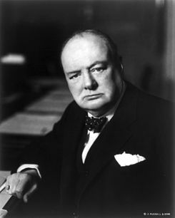
Winston Churchill’s affect on his Generals
He was a strong and inspirational leader,
before the Battle of Britain his speech was
able to bring the troops out of dark times
and into victory.
As a graduate of the Royal Military Academy
he was considered one of the greatest military
strategist and always made sure the army was
in the best position to win.
His ability to foresight the actions of WWII made
his army and Generals very prepared compared
to the other armies.

Slide 10
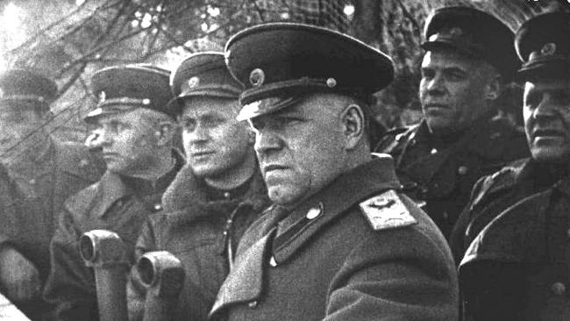
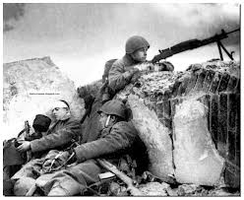
General Georgy Zhukov (USSR)
Background
  July 1915 was conscripted into the Russian army during WWI
  1917 after the October Revolution he joined the Red Army
  After Stalin’s Great Purges he was selected to command the First Soviet Mongolian Army Group in charge of trying to stop Japanese aggression
  January 1941 he was promoted to Chief of General Staff of the Red Army
Defending Kiev and Moscow
  July 19 1941 he was demoted from Chief of General Staff when he proposed to evacuate Kiev, he then became in charge of the defense of Moscow and successfully defended it.
Stalingrad
  November 19 1942 after he was out in charge of the defense of Stalingrad he launched Operation Uranus (a massive counter attack) that ended up surrounding German’s 6th army at Stalingrad
  February 2 1943 the German’s surrendered and were forced out of the Soviet Union
Last Stages of WWII
  June 22 1944 led an operation into Poland that became a huge triumph
  May 8 1945 after leading troops into Germany he oversaw the surrender at Berlin that ended WWII
Georgy Zhukov overlooking his army overwhelm the Germans at Stalingrad
The troops of Geordy Zhukov’s troops protecting Russia from the Nazis during the battle of Stalingrad

Slide 11
General Georgy Zhukov (USSR)
What made him a great General?
  He lived by the motto of “never give up” and that was a major part of his success. He was relentless with his strategy and continued to attack until there was absolutely no way that he was going to win.
  He planned his operation with extreme detail. He came to every battle prepared for every situation. He came to the battlefield more prepared then the opposing General and that gave him a tremendous advantage.
  He had a reputation of being extremely tough and strict on his troops. He instilled the fear of discipline into his soldiers that forced his soldiers to be at their best at all times plus it created extremely tough, strong, and fast soldiers that gave him an advantage on the battlefield.

Slide 12
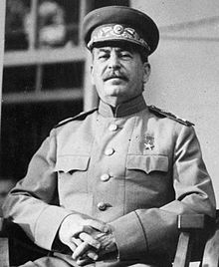
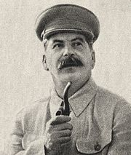
Joseph Stalin’s affect on his Generals
He installed fear into the mind of his
Generals when he killed the military
elite during the Great Purges
Joseph Stalin was always paranoid
and scared that the Generals were
plotting against them, so he always
made sure he oversaw everything
that his Generals did
As a totalitarian dictator he has
full control of everything and has
final decision on everything example
being when even after he was advised
to evacuate Kiev he decided not to

Slide 13
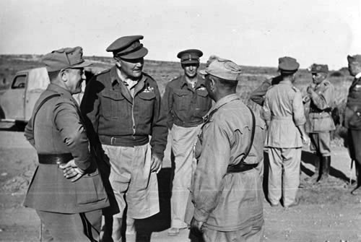
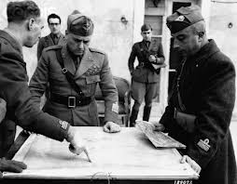
General Giovanni Messe (Italy)
Background
  1927 he was named Colonel of the Royal Italian army
  1935 he was promoted to Brigade General and put in command of the motor brigade
Second Italo-Abyssinian War
  1935 he joined the 2nd Italo-Abyssinian War as a Brigade General and became a important role in conquering Ethiopia
  1940 right before the outbreak of WWII he was sent back to Italy and took command of the Italian Armored Division
Italo Greek War
  October 1940 commanded a Corp of Italian troops in the Italo Greek War
  April 1941 with German help he led the Axis to victory in Greek
Russia
  1941 after the Italo Greek war he was sent to Russian to led a small light army
  July 1942 his troop was replaced by a much bigger Italian army
North Africa
  January 1943 he was sent to Tunisia to fight the British troops
  May 12 1943 he was forced to surrender and flee Africa the same day he became Marshal of Italy
May 12 1943 Giovanni Messe surrendering to the British after a loss in Tunisia.
Giovanni Messe going over his plans before a battle in Tunisia

Slide 14
General Giovanni Messe (Italy)
What made him a great General?
  He had the ability to adapt to any situation. When he was a successful under the crown he didn’t take him long to adapt and find success under Mussolini. That same adaptation ability made him successful when it came to invasions of foreign nations.
  During his military career a lot of times he had to work with small amount of men. To cope with the small man power he grew the ability to get the most out of that small group of people. He now was able to take much smaller groups of people and battle against much larger armies because he trained them to the become the best soldiers that they possible could have become.
  Going into WWII he had a leg up on the rest of Europe. After fighting in the 2nd Italo-Abyssinian War his troops were prepared and were filled with recent experience. The opposing Generals were not ready for the war while he was still riding the success of the 2nd Italo- Abyssinian.

Slide 15
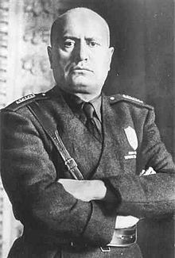
Benito Mussolini affect on his General
As a Fascist leader he was the ultimate
dictator and made every choice for Italy
and had final decision over every single
one of his Generals
He led his army using his charm
and his inspirational abilities
using them he was able to lead
his army to great victories
His strong ties with Adolf Hitler
gave a huge and powerful ally
for his generals to utilize

Slide 16
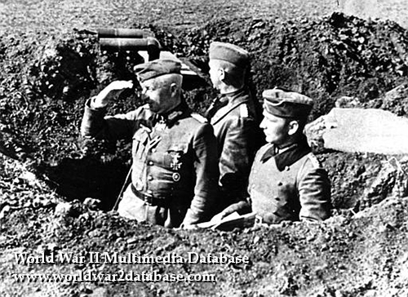
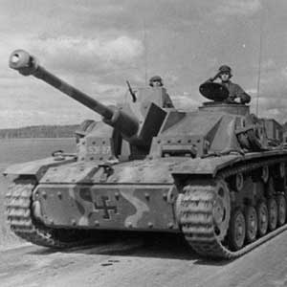
Erich Von Manstein (Germany)
Background
  1915 during WWI he was promoted to Captain after being wounded
  1935 with rise of Nazi party he became Colonel
Invasion of France
  May 1940 he was the major contributor in making the plan to invade France his plan would be know as the Manstein plan but he wouldn't’t take part of the actual operation
Invading the Soviet Union
  February 1941 took command of the 56th Panzer Corp during Operation Barbarossa
  June 22 1941 he advanced far into the Soviet Union and captured the cities of Dvinsk, Demyansk, Crimea and Torzhok
  September 1941 took command of the 11th army and was able to capture Crimea but at Leningrad his army took a huge loss
  November 1942 he was sent to Stalingrad to rescue the 6th army but he was forced to retreat because of the Red Army
Last stages of his career
  March 1943 his proposition to invade the Soviet Union was rejected by Hitler
  February 1944 he disobeyed Hitler and order Corps out of the “Cherkassy Pocket”
  March 1944 he was dismissed and was not in office during the fall of the Nazis
Erich Von Manstein overlooking his troops capture the Soviet town of Crimea
The Sturmgeschutz assault gun was created by Erich Von Manstein and was a big part of his military firepower

Slide 17
Erich Von Manstein (Germany)
What made him a great General?
  He was able to plan out brilliant operations that greatly benefited the Germans. It was his plan, the Manstein plan, that was a major contributor for the success of the Germans during the fall of France.
  Not only was he a smart military strategist. He was a genius when it came to military machinery. He invented the StuG III assault gun that later became a huge arsenal now only with his troops but with most of the German army. His ability to work with the weapons was key for his success as a General.
  He had the ability to be on the good side of Adolf Hitler. Especially in the yearly parts of WWII Hitler had been a strong supporter of him and that allowed him to take advantage of the strong military plans that he had come up with.

Slide 18
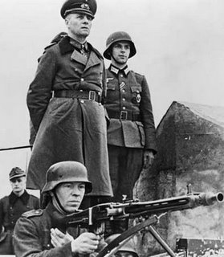
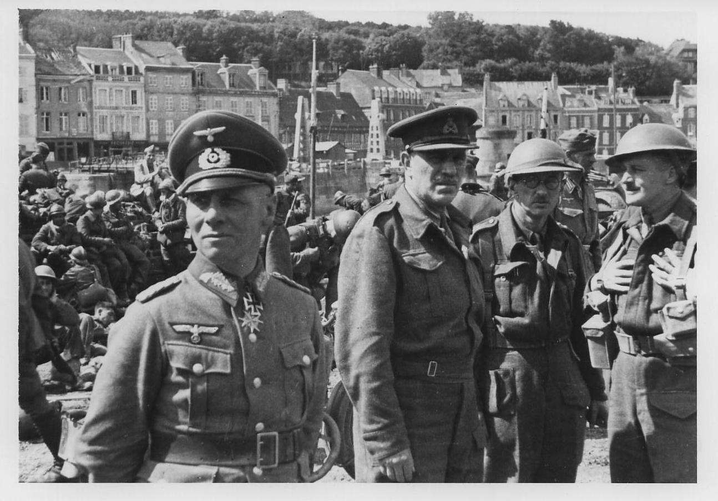
General Erwin Rommel (Germany)
Background
  1917 during WWI he was promoted to Captain
  1937 promoted to Colonel and accompanied Hitler in the Polish front to start WWII
Invasion of France
  May 10 1940 he led the 7th Panzer Division to great victories through France that culminated with the fall of France
North Africa
  Feburary 1941 he arrived in Libya, although technically under the Italians
  March 24 1941 he advances into the British post of El Aghelia
  April 6 1941 he continued to advanced far into British territory
  November 1941 he was forced to retreat back to El Aghelia
  May 26 1942 culmination of a series of German counter attacks led to British retreat
  February 1943 after Operation Torch and a series of British wins the Germans continued to have their position worsen
  Match 9 1943 he was forced to leave North Africa
Normandy
  June 6 1944 in the wake of the invasion of Normandy he was rushed to France
  July 17 1944 he was wounded and was forced to leave Normandy
Plot to kill Adolf Hitler
  July 20 1944 he had a failed attempt to try and kill Adolf Hitler
  October 14 1944 he took a Cyanide pill and killed himself after being found guilty of treason
Erwin Rommel overlooking his army battle in North Africa
Erwin Rommel in June 1940 after he capture thousands of British soldiers during his invasion of France

Slide 19
General Erwin Rommel (Germany)
What made him such a great General?
  He had the ability to dramatically change the outcome of a battle in one courageous action. He never stooped going after his opponent and he was relentless with it and because of that a battle was never over for him and because of that the opposing Generals were always stressed out and always nervous.
  Although he spent most of his time serving under other Generals he routinely out shined those people that were above him. He was believed by the Germans to have a sixth sense when it came to the battlefield.
  It was his ability on the battlefield to absolutely destroy the opponent with one insane move that scared the Allies and he regularly stressed the opponents Generals.

Slide 20
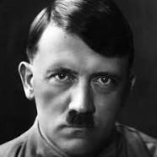
Adolf Hitler’s affect on his Generals
Has a Fascist dictator he had the ultimate
decisions on every military choice and
he made the important decisions
He relied heavily on a group
of Generals that he trusted heavily
and allowed his Generals to work
very freely considering he was a Fascist
dictator
His close alliance with Mussolini gave his
army a strong ally to be able to rely on and
put his Generals in the best position to succeed

Slide 21
Additional Links
Video Biography on Erwin Rommel
Video Biography on George Patton Jr.
Video Biography on Dwight Eisenhower
Military Career of Bernard Montgomery
Military Career of Erich von Manstein
Military Career of Dwight Eisenhower
Military Career of Erwin Rommel
Military Career of George Patton Jr.
Military Career of Georgy Zhukov
Military Career of Giovanni Messe
Timeline of WWII
Documentary from D Day to fall of Berlin
Documentary on the battles in North Africa

